Slide 2
Co-R
On
Off
R
A
Co-R
On
Off
R
A

Slide 3
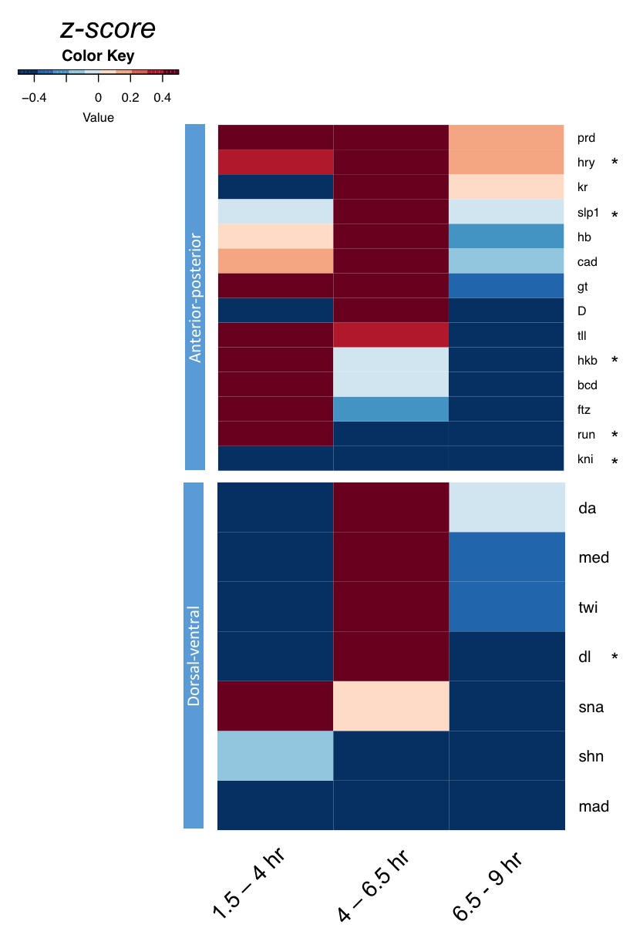
Gro colocalizes with multiple developmental factors

Slide 4
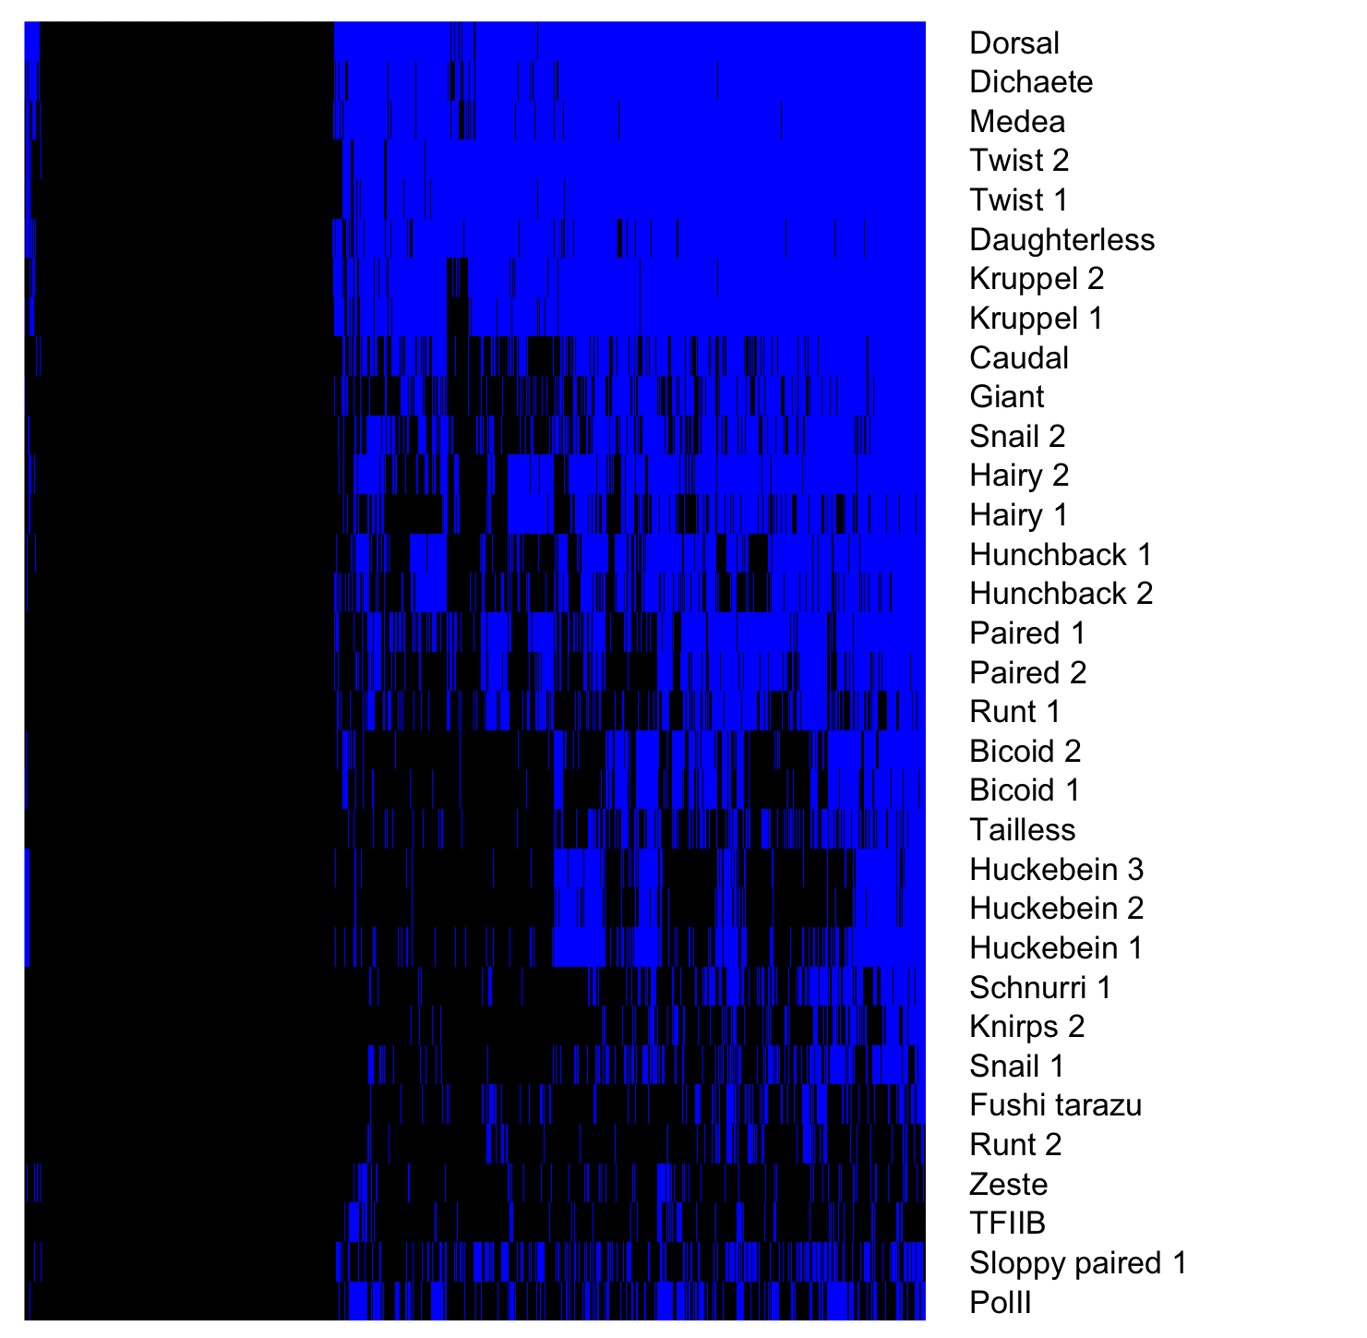
Gro binding sites overlap many additional TFs
Gro binding sites, 1.5 – 4 hr embryos
Factor occupancy

Slide 5
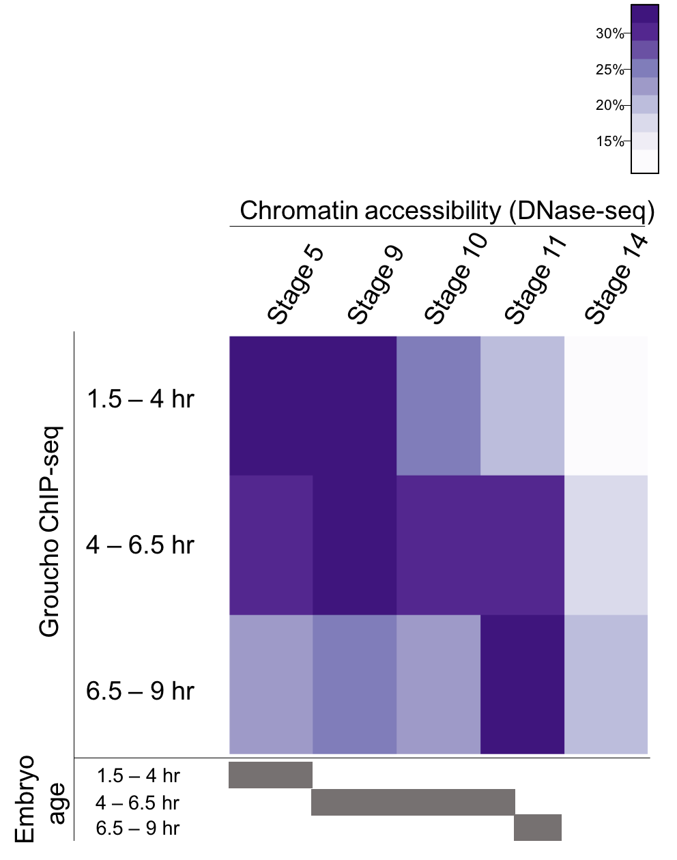
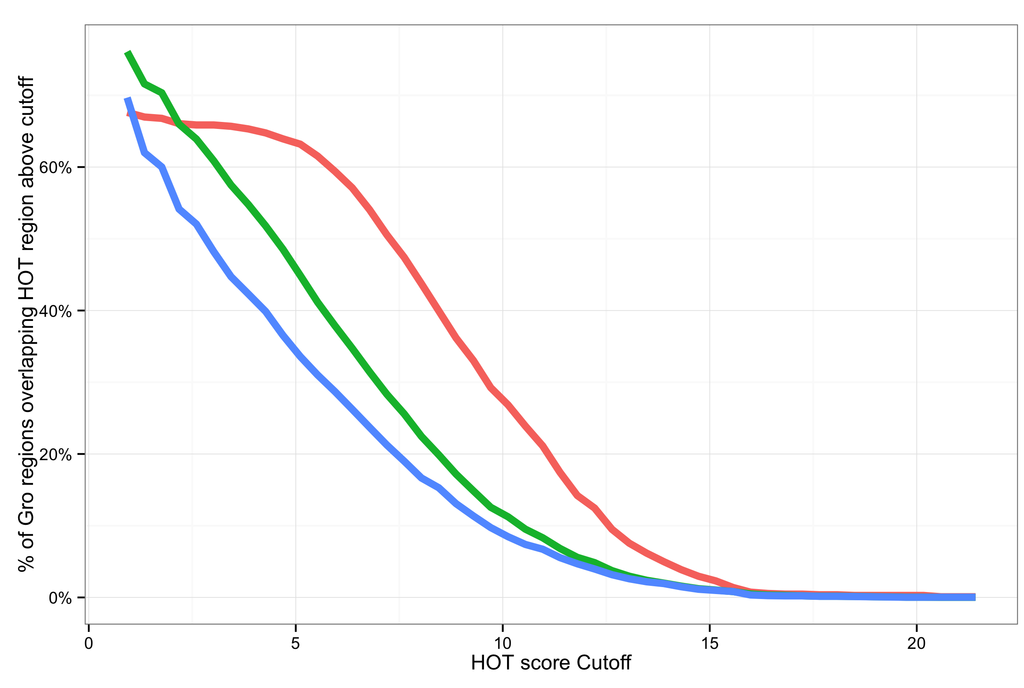
Gro is frequently recruited to areas of high TF density
Notes:
Legend
High accessibility
HOT region explanation

Slide 6
4 – 6.5 hr
3056
1.5 – 4 hr
6.5 – 9 hr
64
1409
782
717
2311

Slide 8
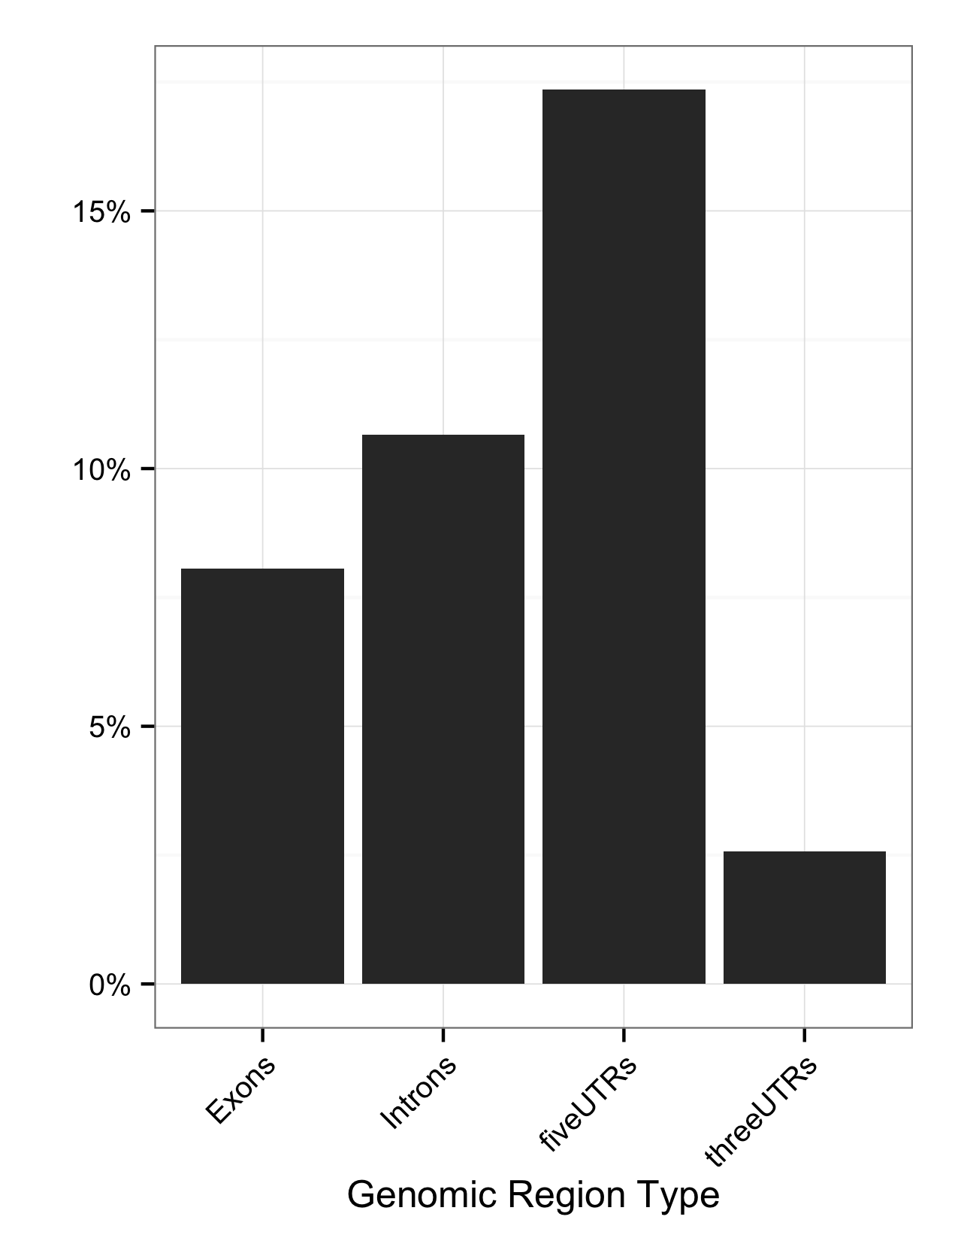
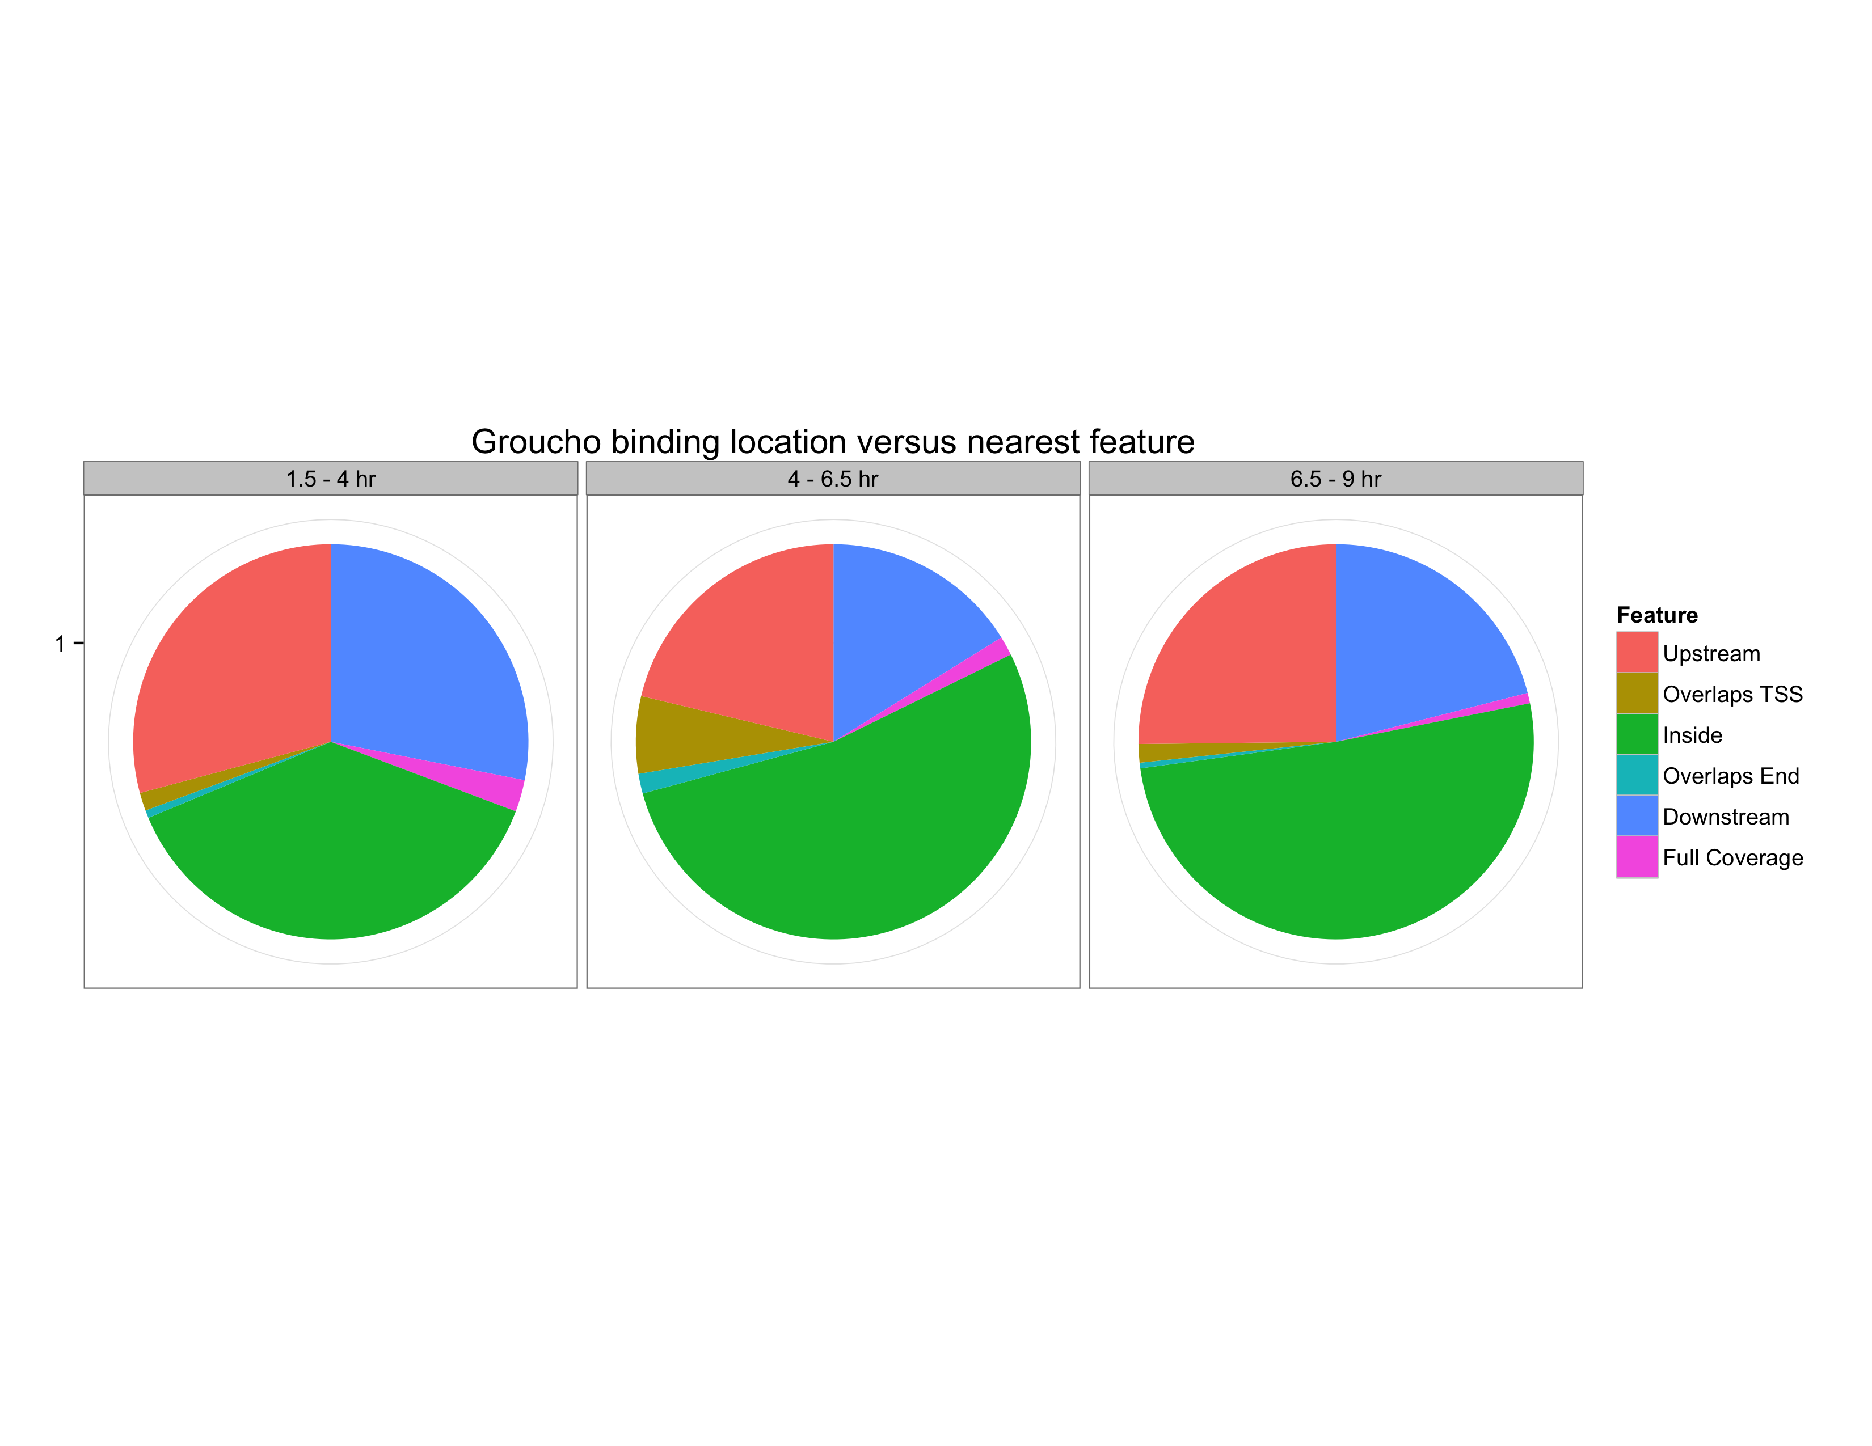
Gro binding is enriched within 5’ segments of genes
Fraction of Gro binding sites
Feature length normalized

Slide 9
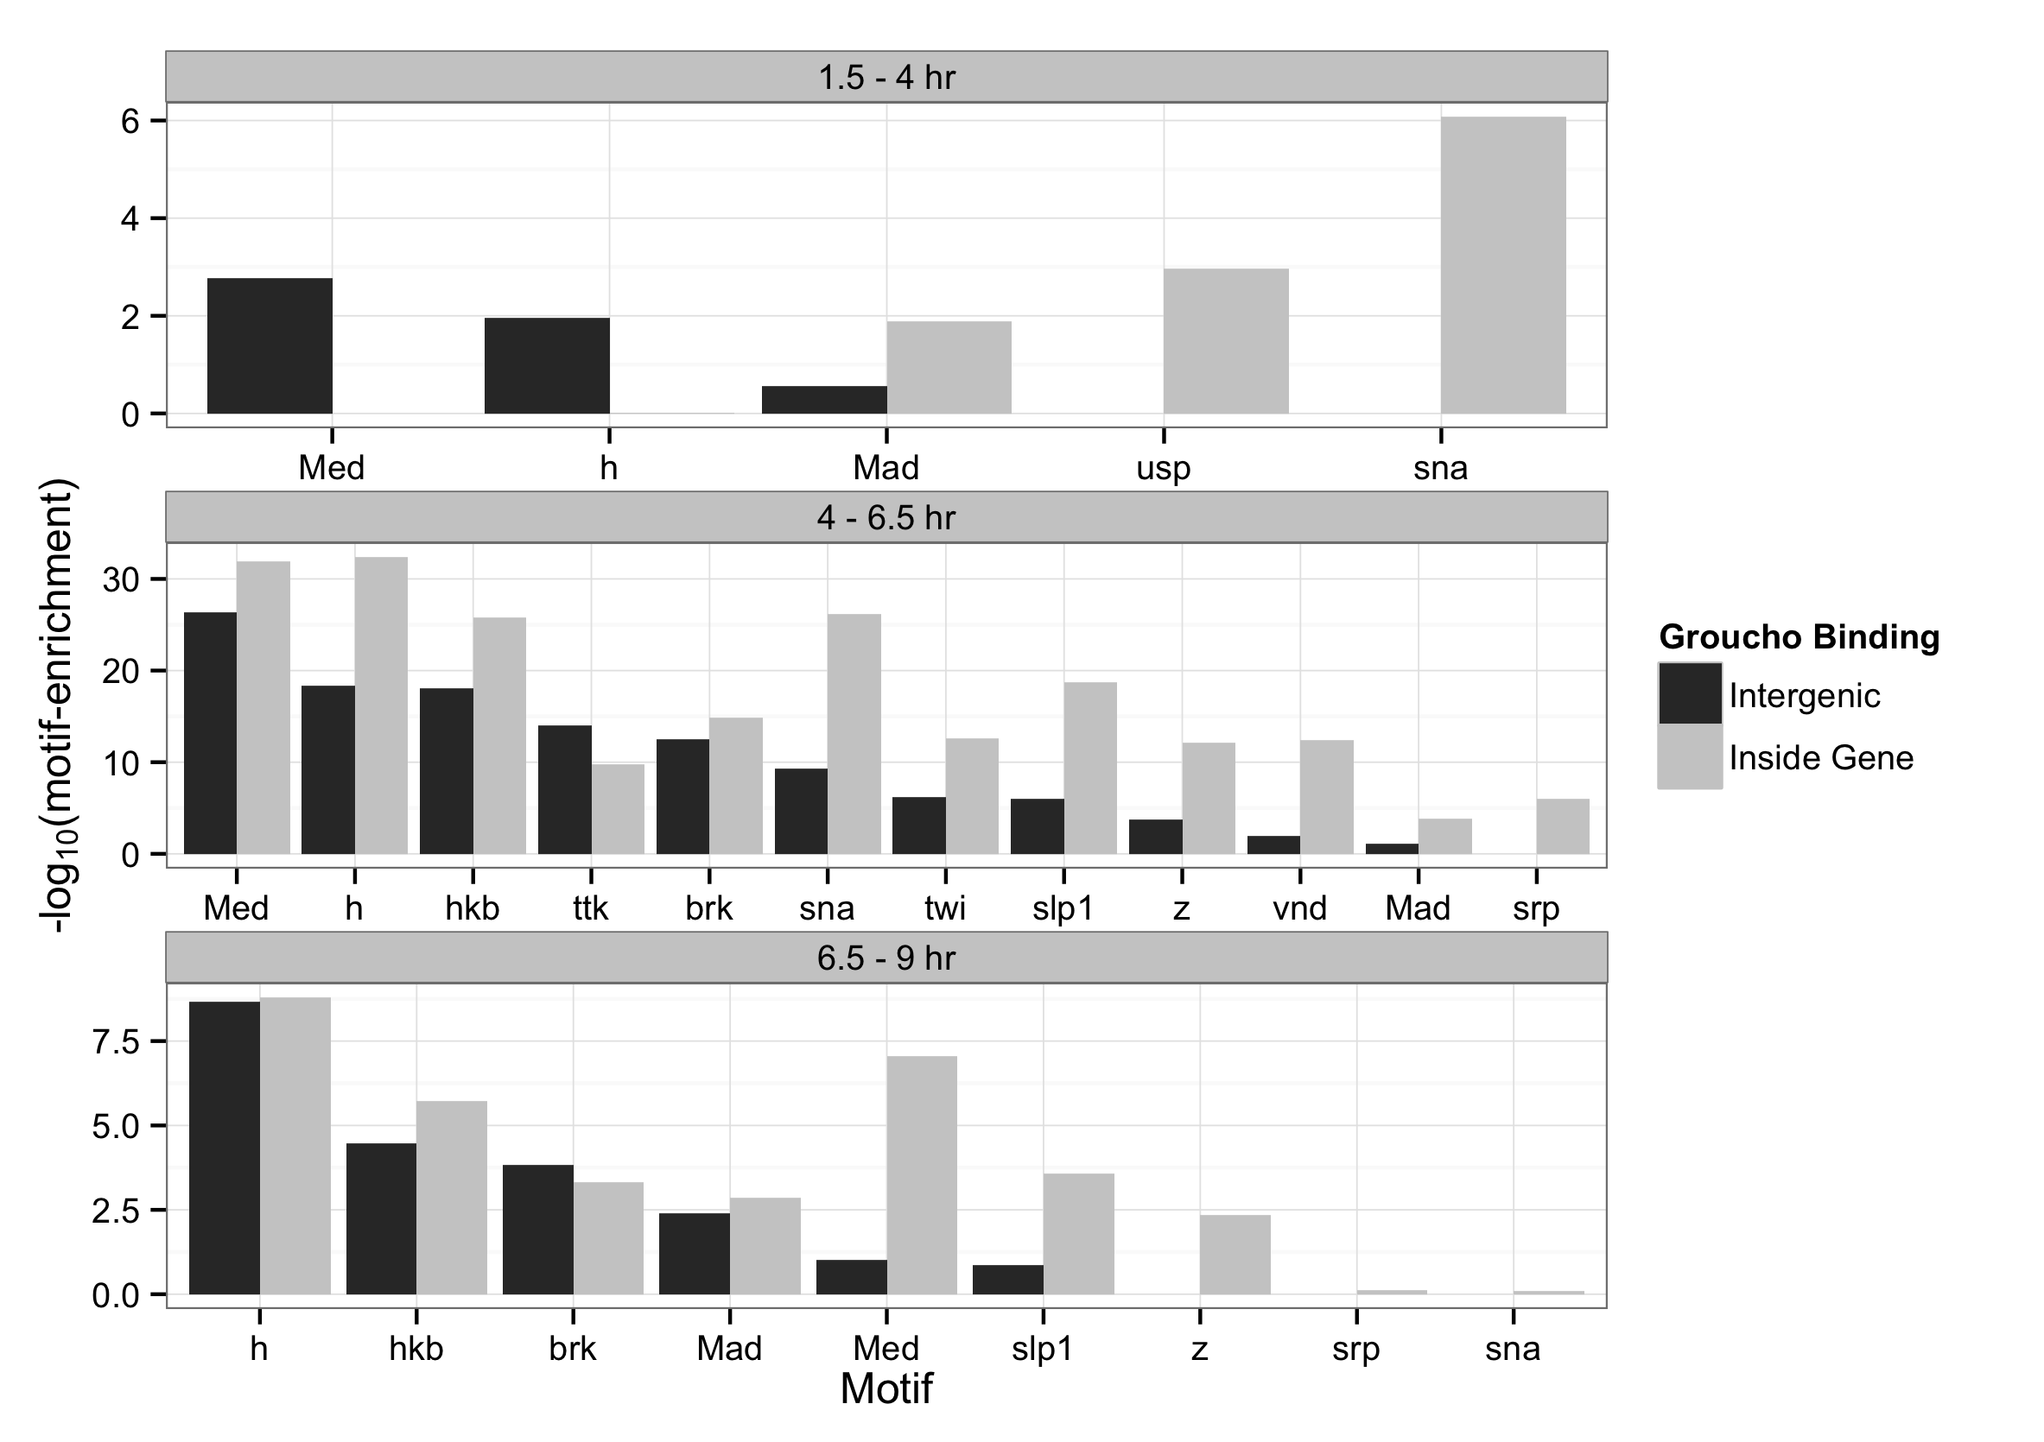
Binding sites are enriched for motifs of Gro-interacting factors

Slide 10
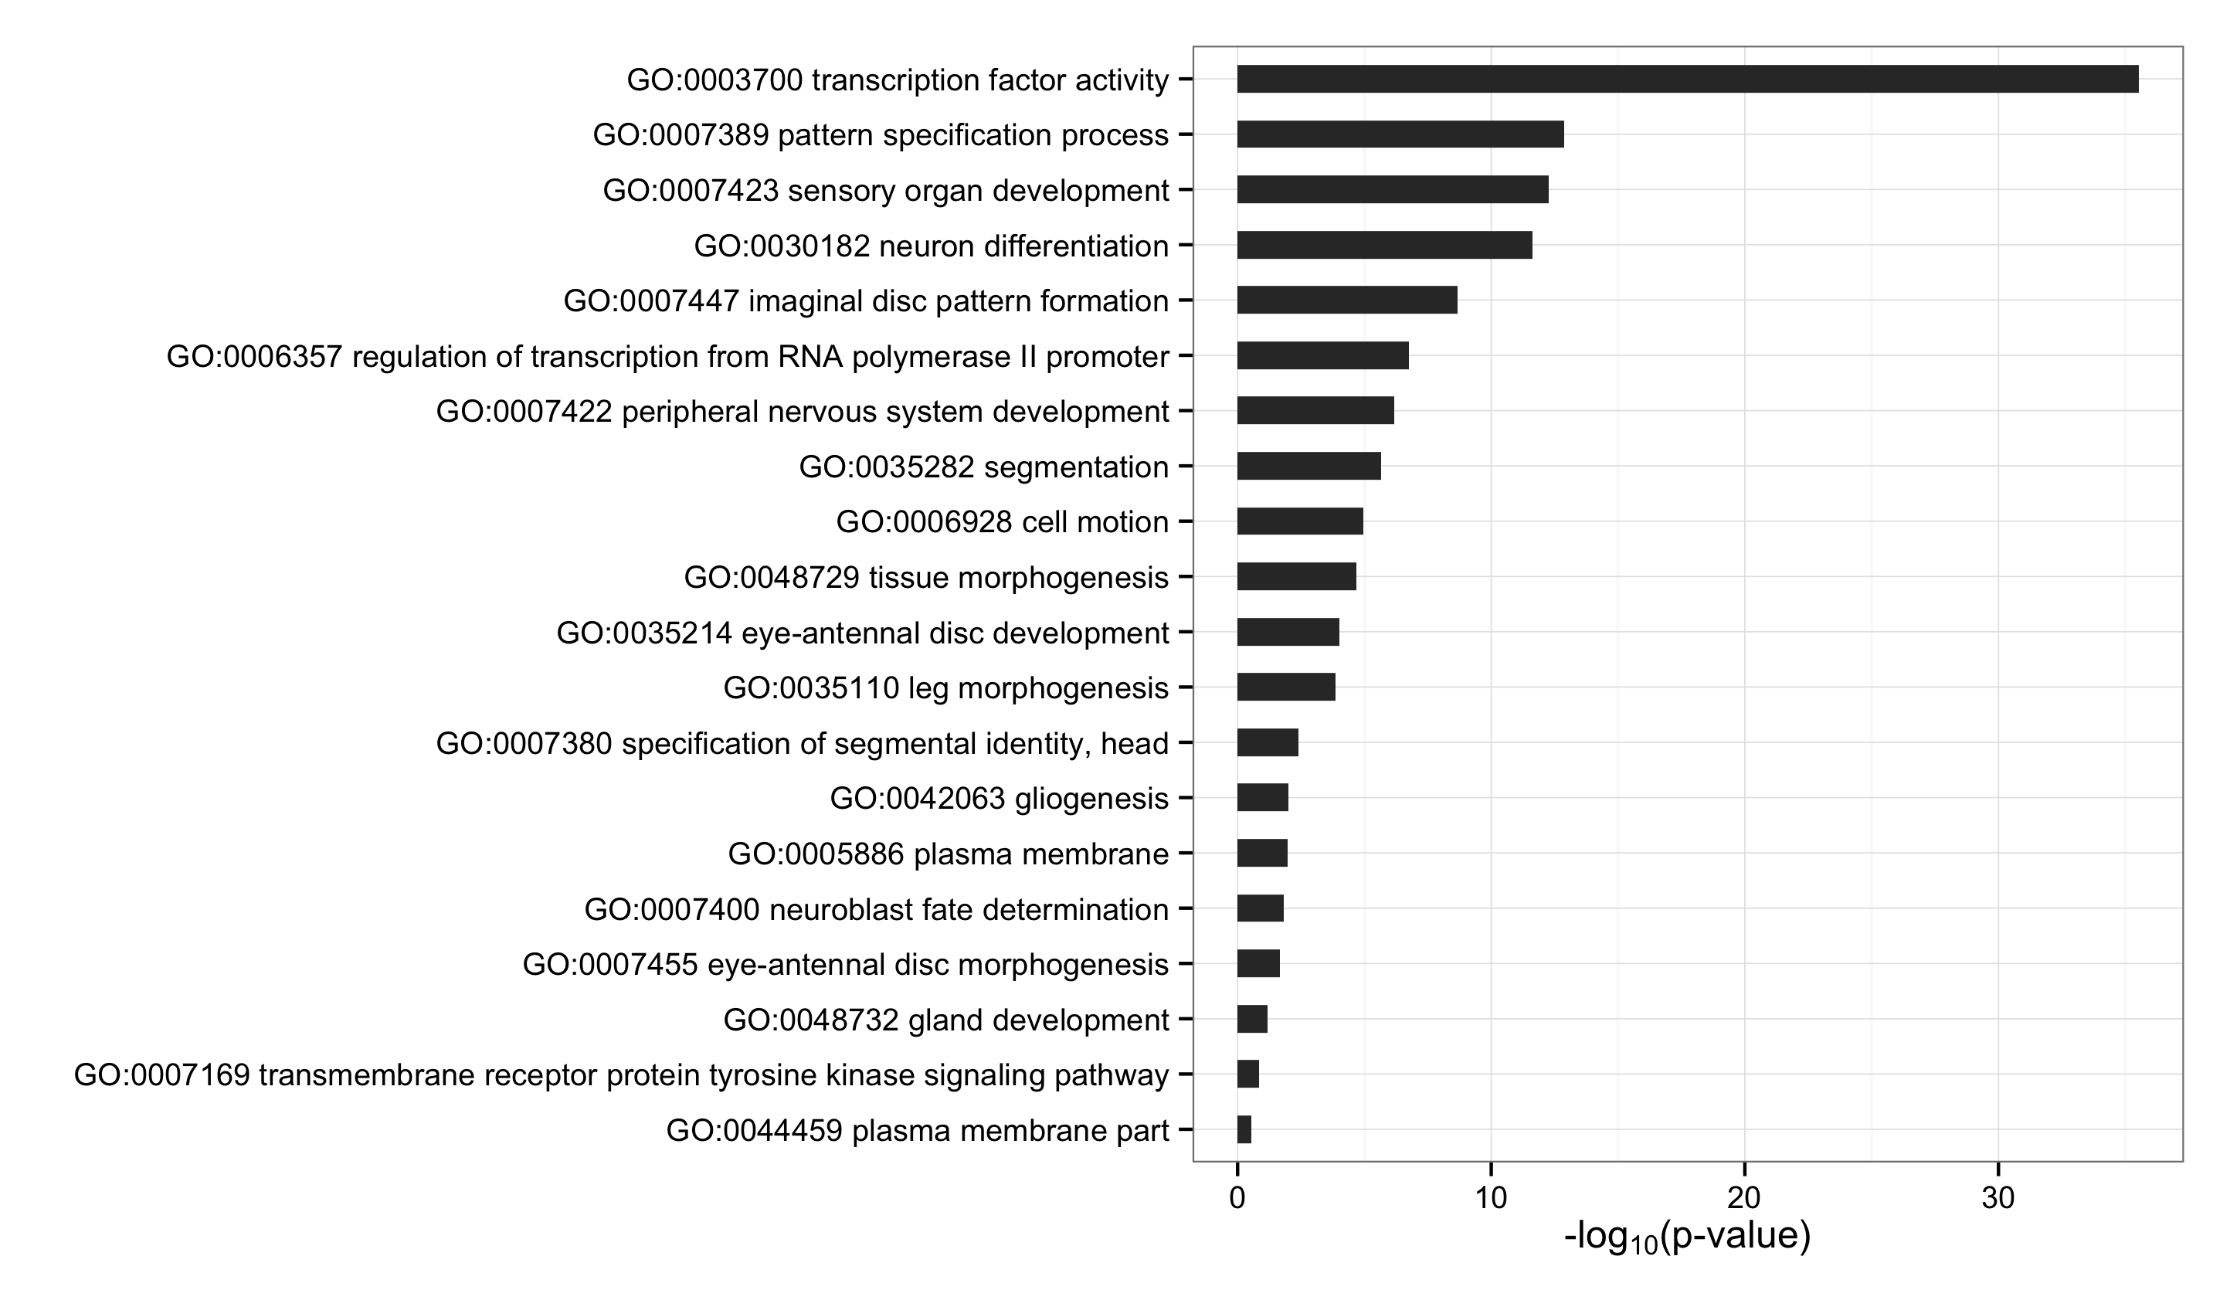
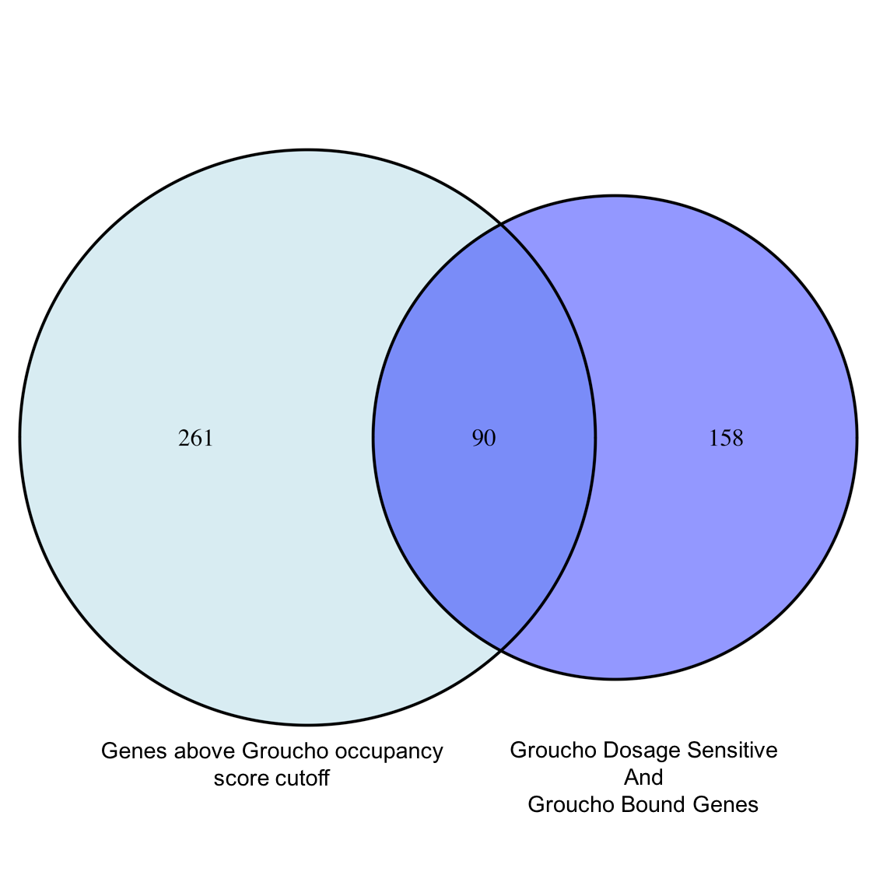
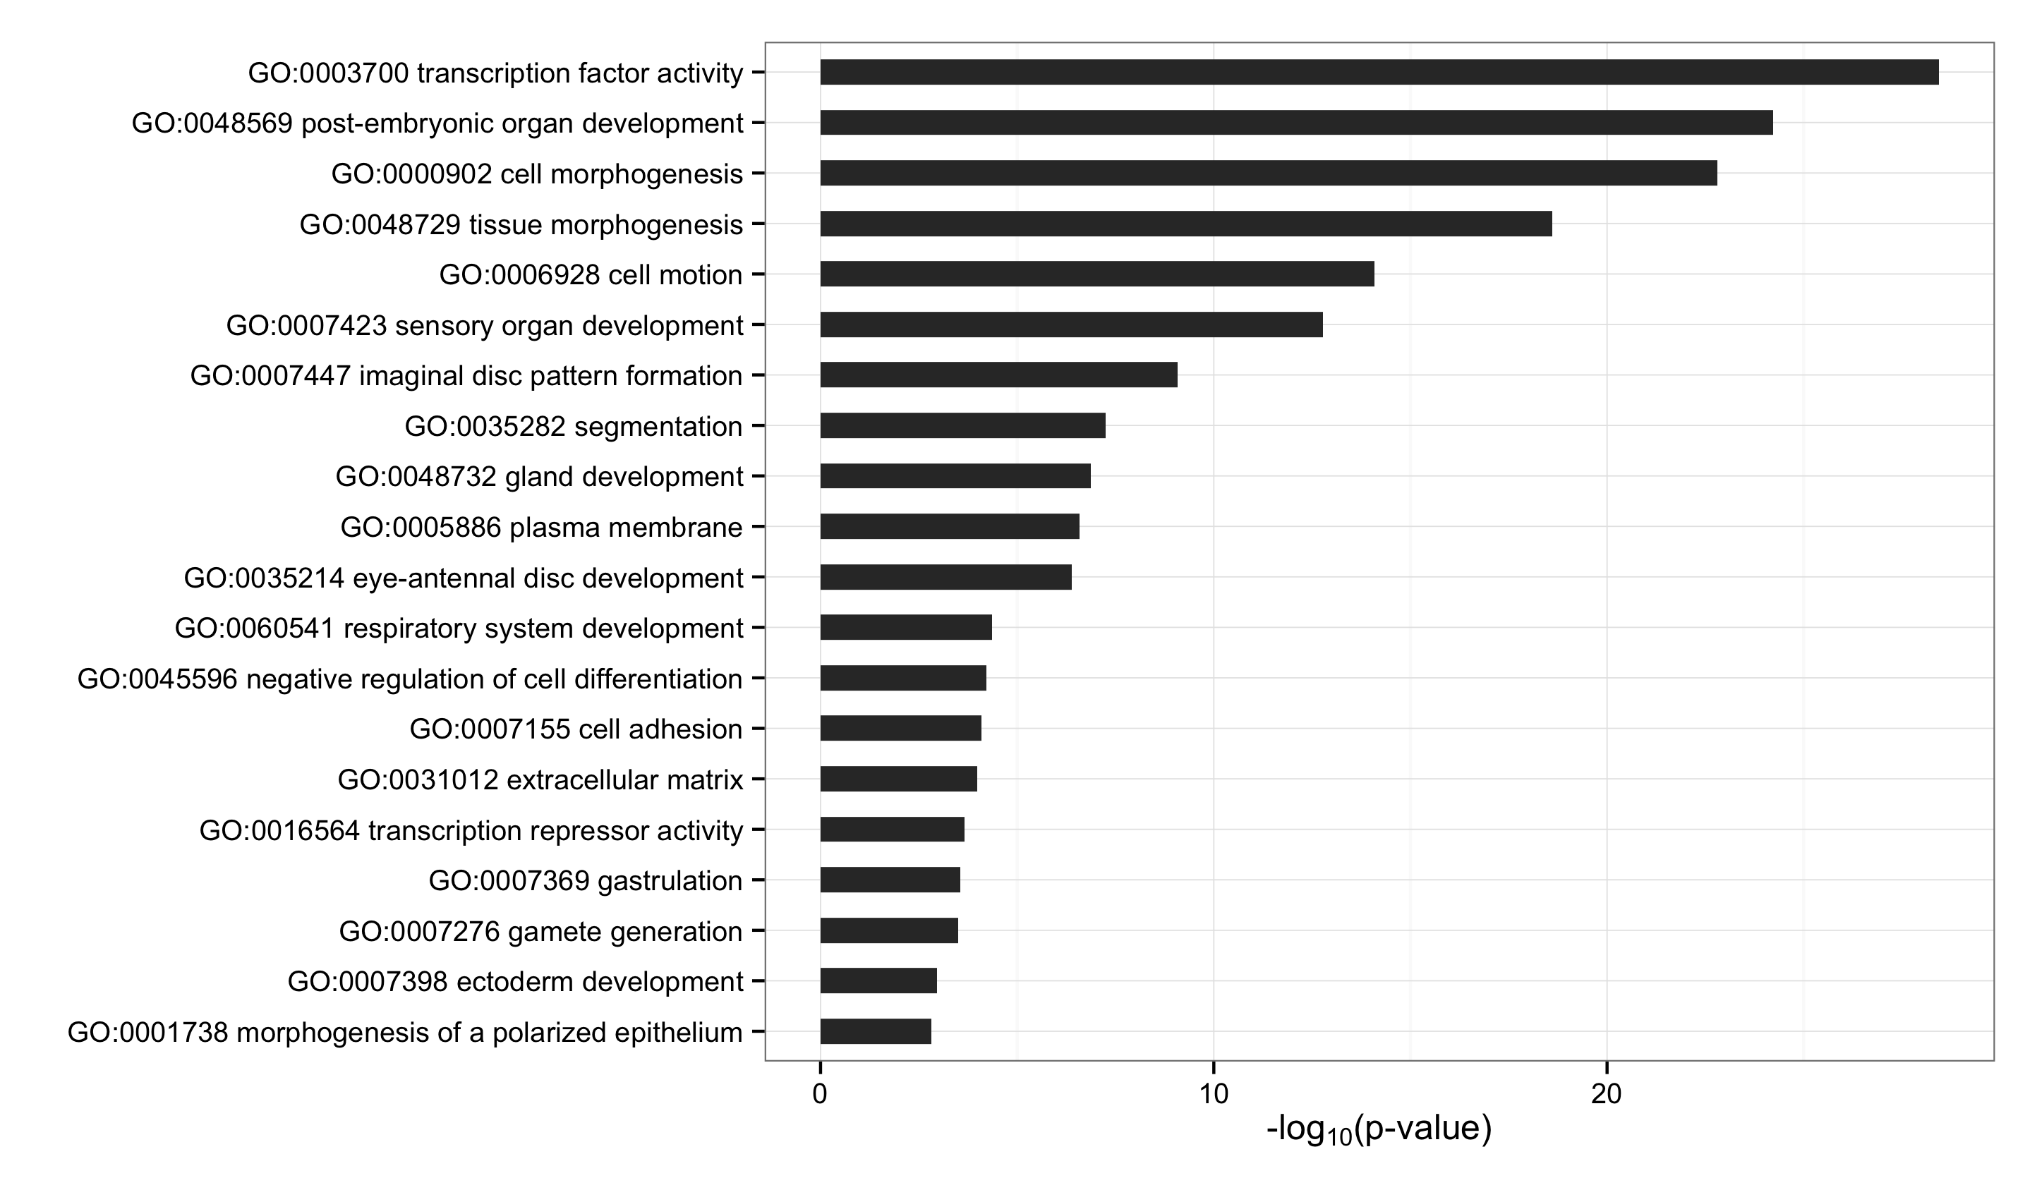
Gro Targets by Dosage Response
Gro Targets by Occupancy Score
Notes:
Focus on gro occupancy

Slide 11
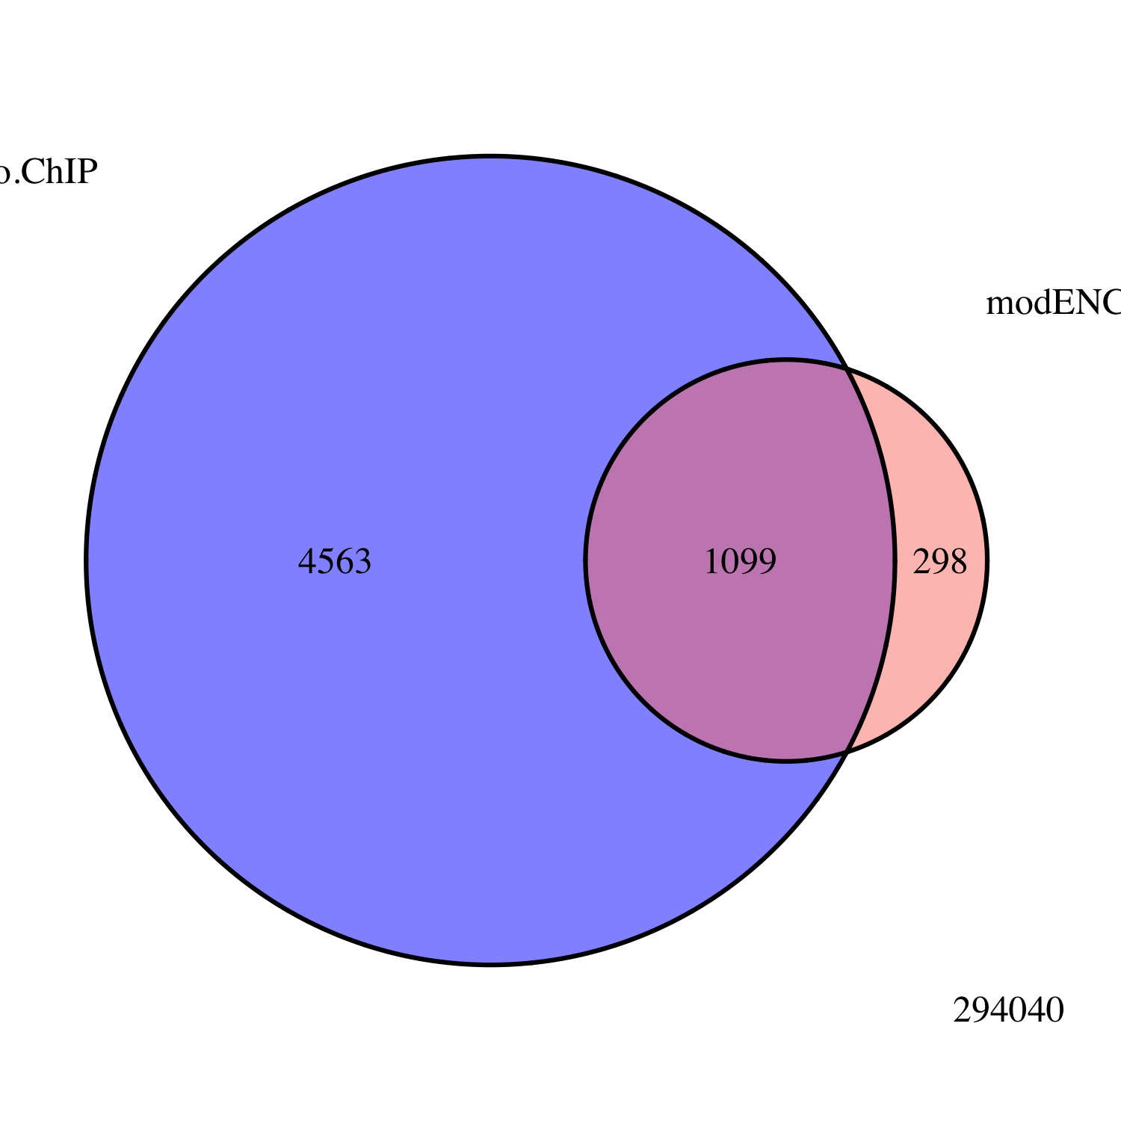
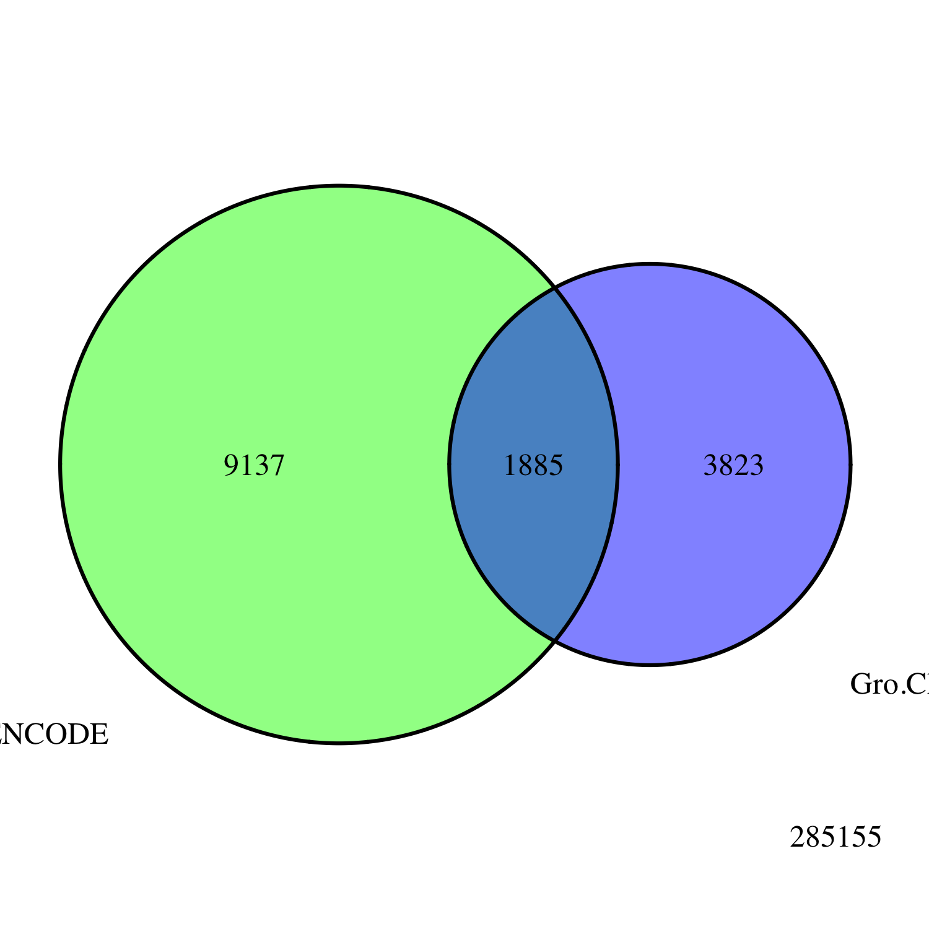
Embryo
Gro ChIP-seq
All Peaks
modENCODE
Embryo
Gro ChIP-chip
Embryo
Gro ChIP
All Peaks
modENCODE
White Pre-Pupae
Gro ChIP-chip
3823
1885
9137
Notes:
Title chip-seq validation

Slide 12
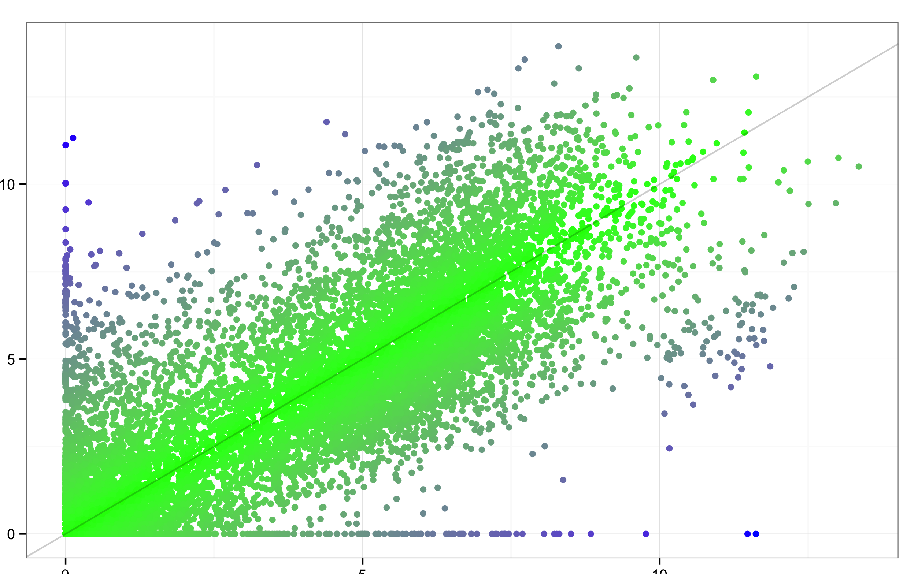
Nascent RNA
Normalized Expression Level (log₂FPM)
poly(A)+ mRNA
Normalized Expression Level (log₂FPM)

Slide 13
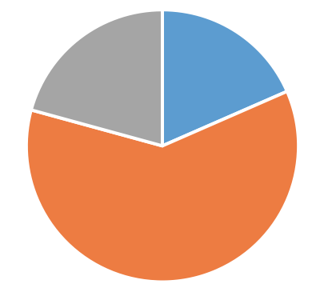
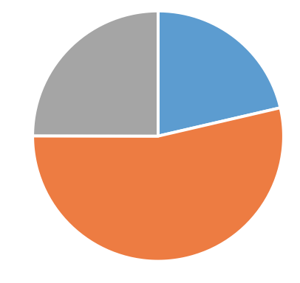
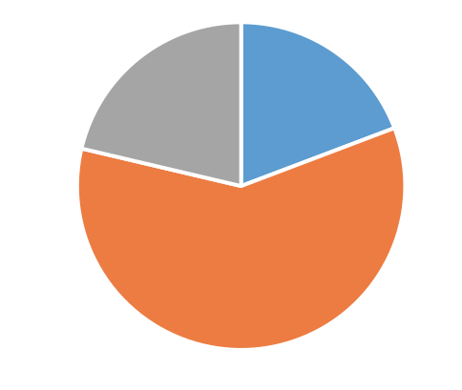

Slide 14
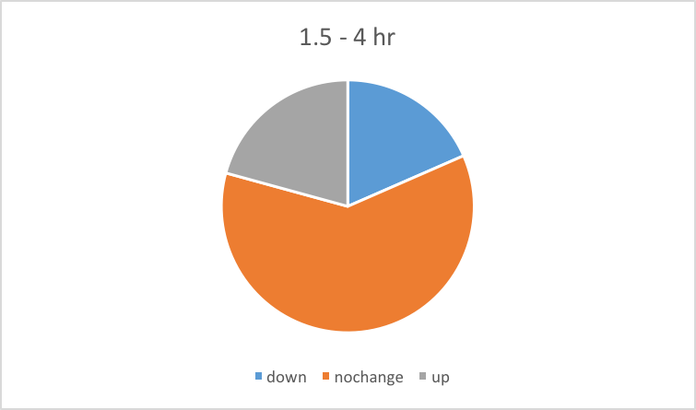
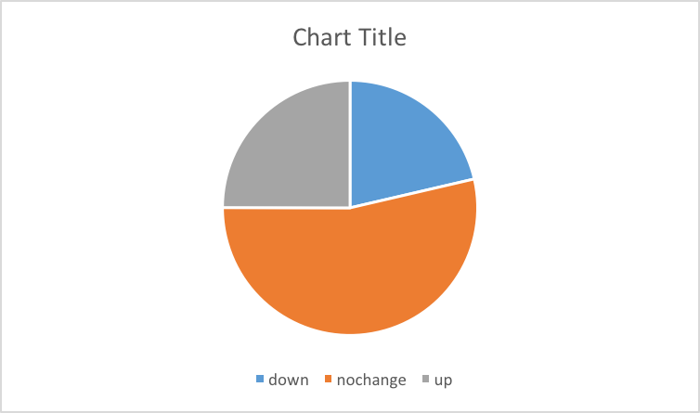
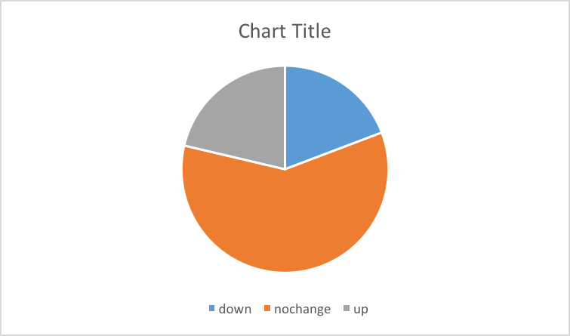

Slide 15
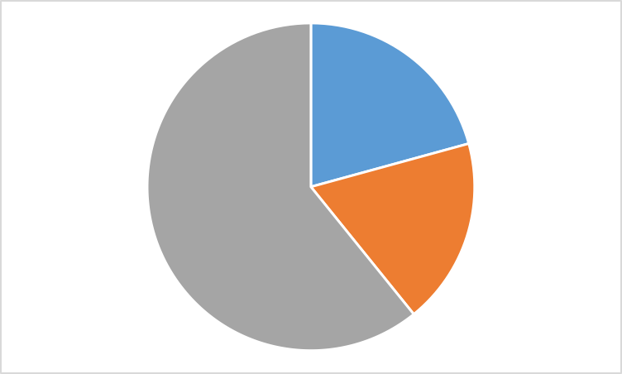
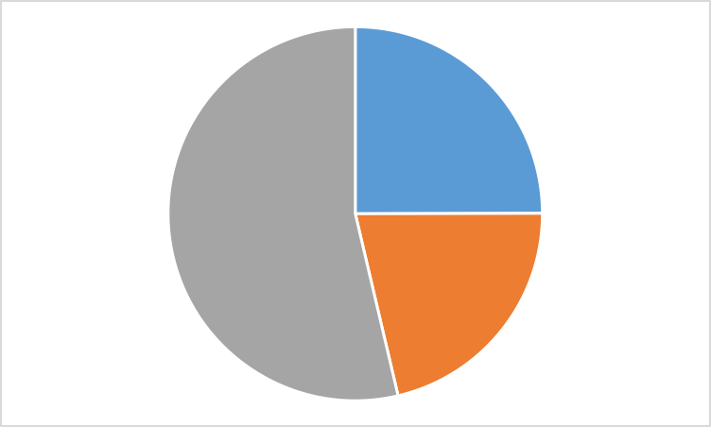


Slide 16
Genic
Intergenic
Intron
Exon
Upstream
Downstream
Distal Intergenic

Slide 17
Spreading or crosslinking as models of repression
R
R
Gro
Gro
Gro
Gro
Gro
Gro
Gro
Gro
Gro
Gro
Gro
Gro
Gro
Gro
Gro
R
Gro

Slide 18
NELF
DSIF
Pol II
PTEFb
P
P
P
DSIF
Pol II

Slide 19
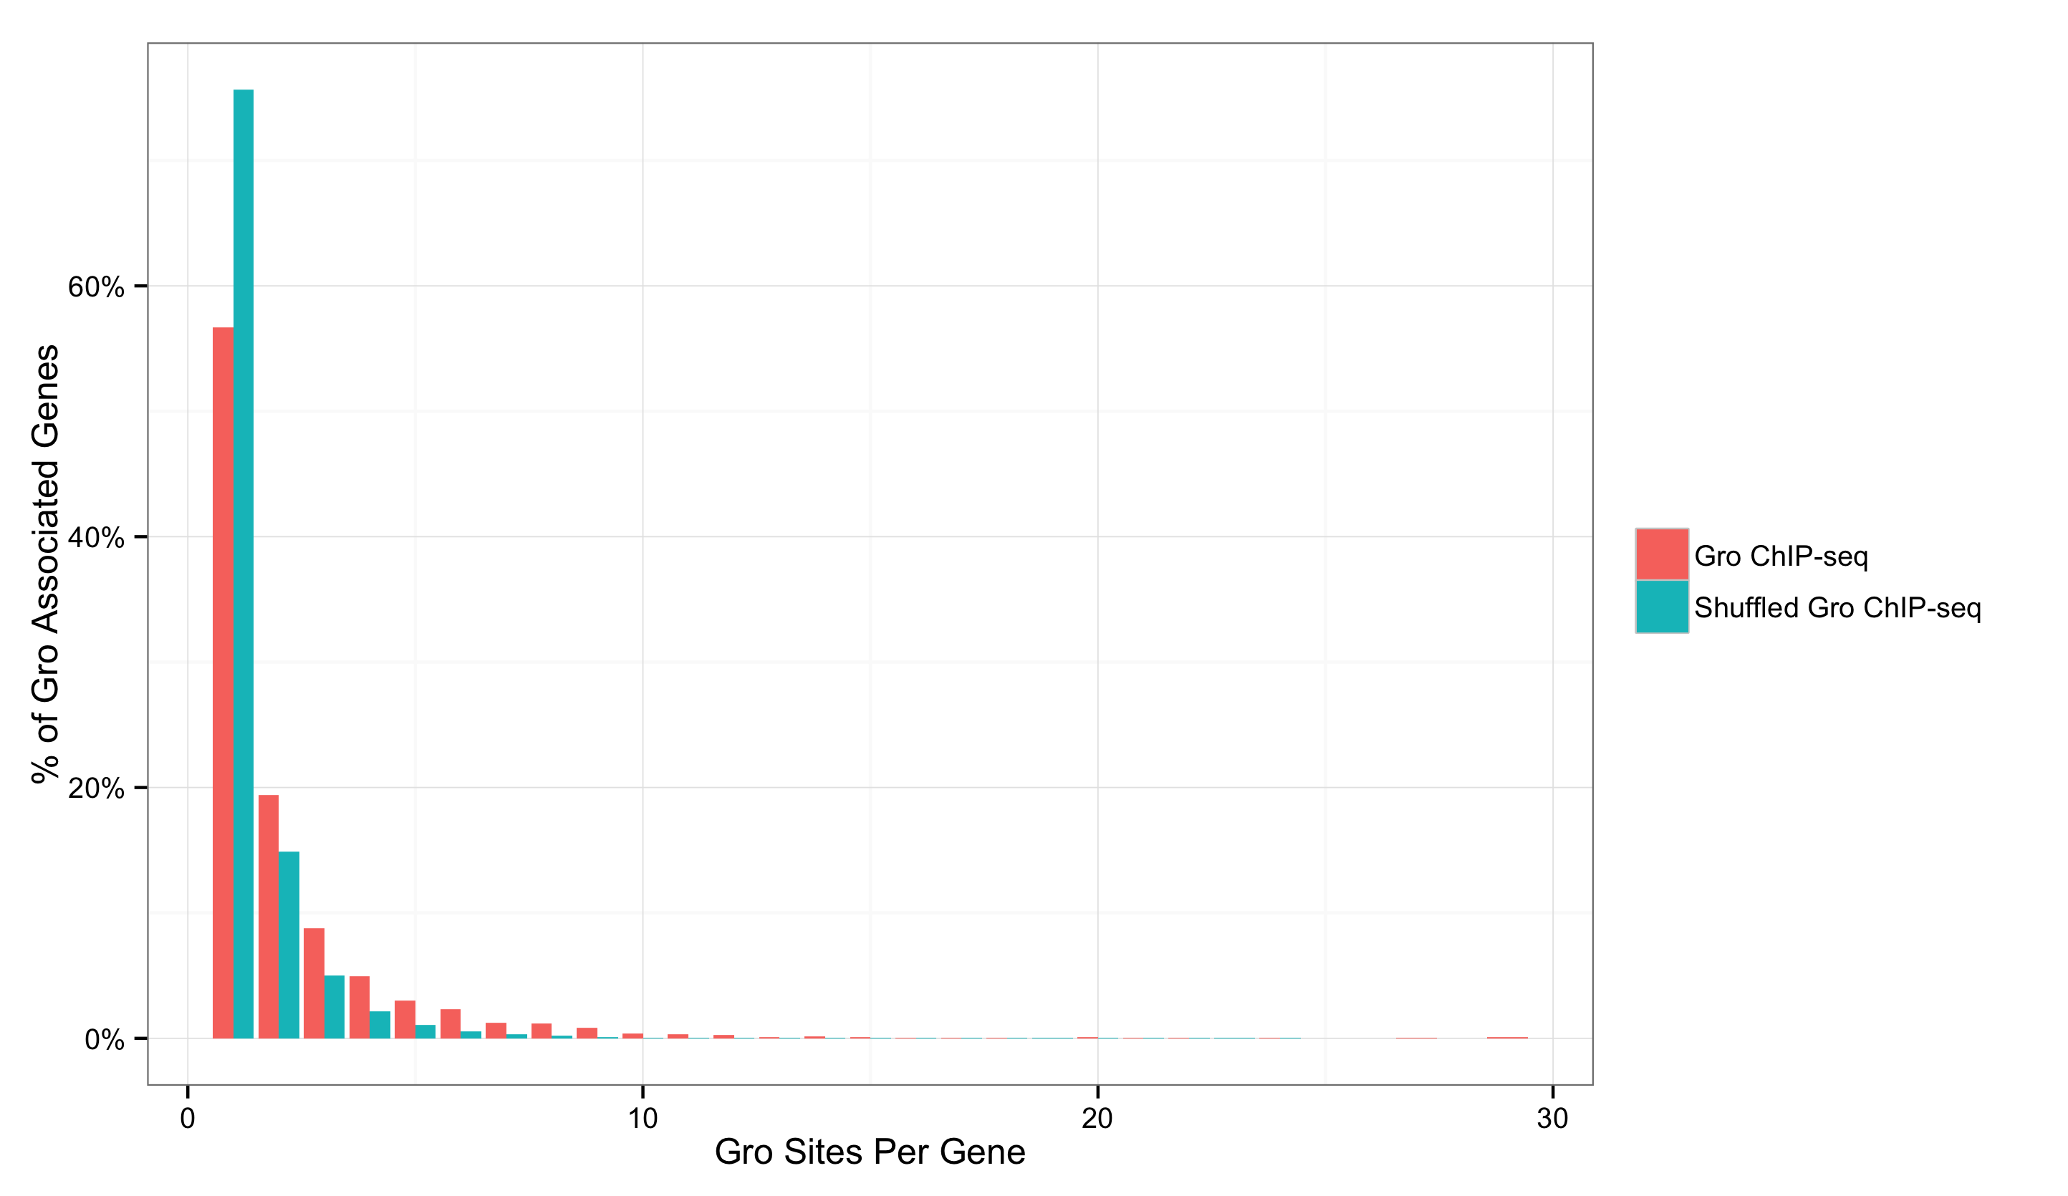
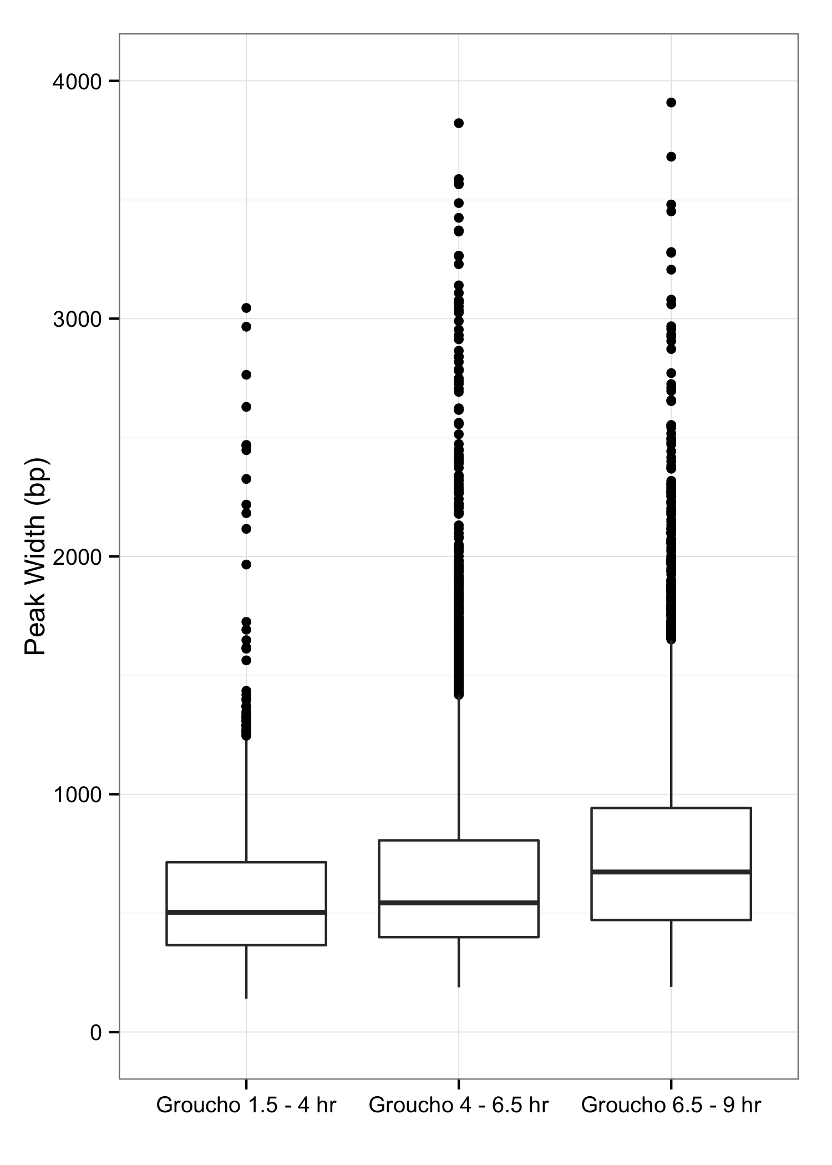
Gro binding is not indicative of spreading in vivo
1
2
3
4
5
Notes:
y-axis
Zaret lab data
label and color for plot
dctbp
Groucho slides cluster

Slide 20
Gro
PTLSNLLS
Dl
Gro
PTLSNLLS
Dl
Dri/Ct
AT-rich region

Slide 21
wild-type
Gro
loss-of-function
Gro
overexpression
Transcriptome
Transcriptome
Differentially expressed genes

Slide 22
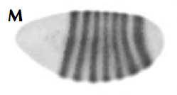
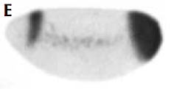

Slide 23
Repression
High affinity
Activation
Activation
Low affinity
Repression

Slide 24
If Gro spreading is rare, how does it participate in long-range repression?

Slide 25
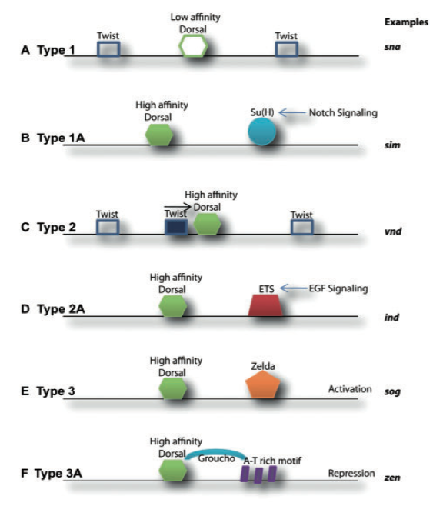
Is Gro recruitment sufficient for repression?
Type 3
(dorsal ectoderm)
Low
Embryo
Embryo
Cross-Section
Type 2
(neuroectoderm)
Nuclear Dorsal
High
Type 1
(mesoderm)
Chopra and Levine, 2009
Notes:
Title: Is recruitment sufficient for repression

